Slide 1

SETTING PATH IN PYTHON
Second Steps With Python

Slide 2
Setting Path in Python for
Windows Environment

Slide 3
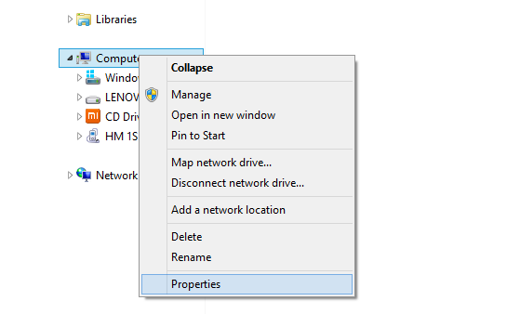
1. Right click on My Computer ->Properties

Slide 4
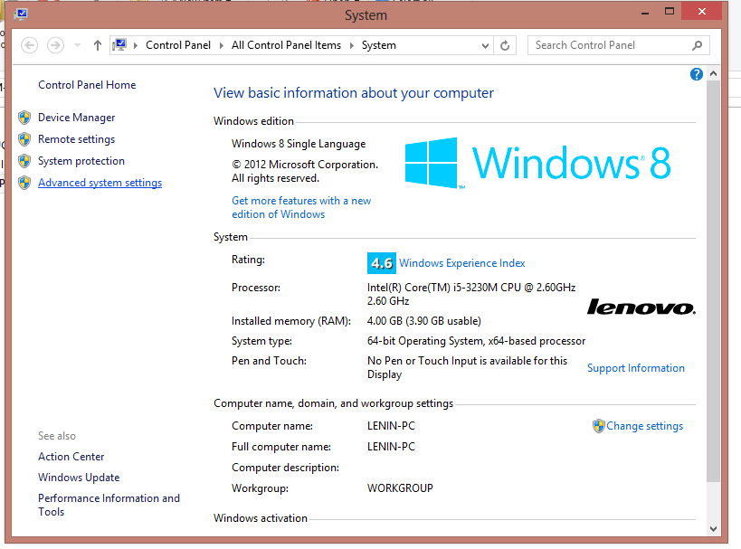
2. Click “Advanced System setting ”

Slide 5
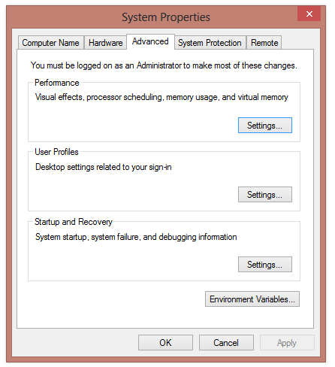
3) click “Environment Variable” button

Slide 6
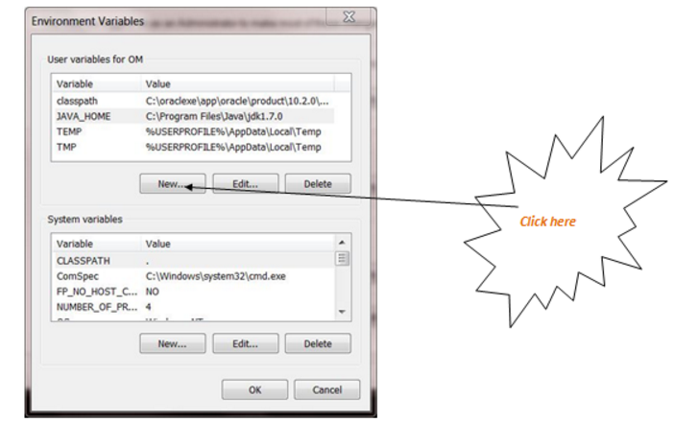
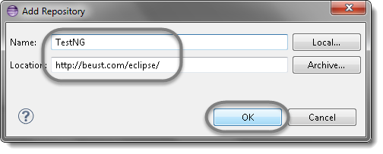
4) Click on “New” tab of user variables.

Slide 7
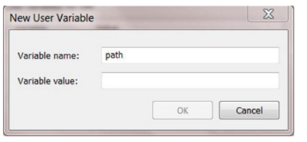
5) Write “path” in variable name

Slide 8
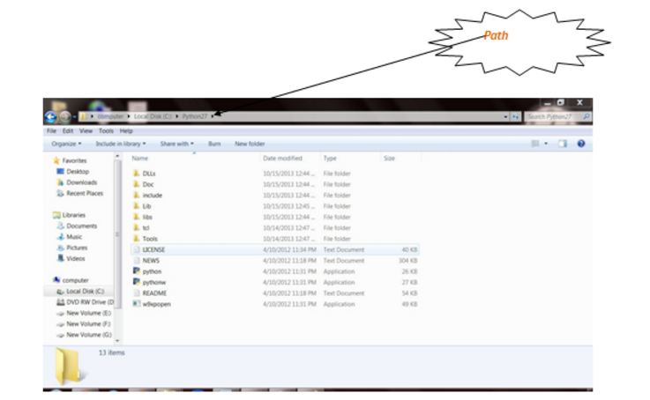
6) Copy the “path of Python folder”

Slide 9
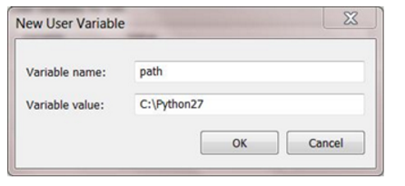
7)Paste path of Python in variable value then click ok button.

Slide 10
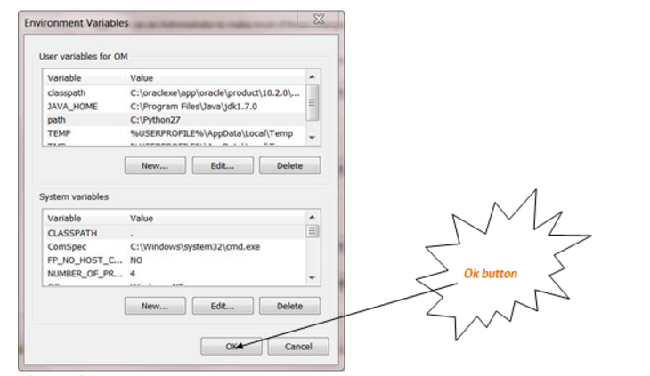
8)Click on Ok button:

Slide 11
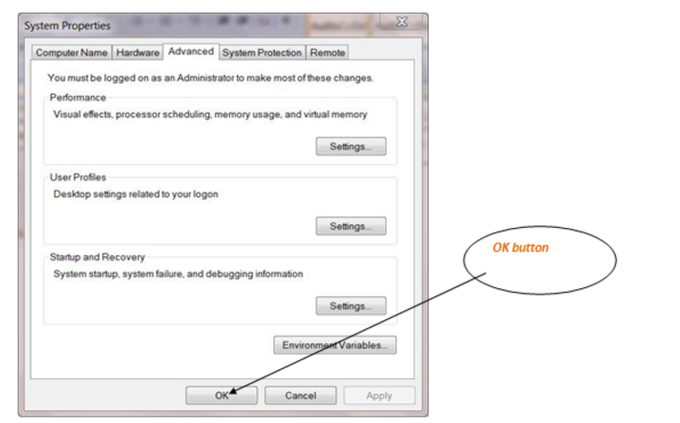
9)Click on Ok button:

Slide 12
Your questions are welcome!

Slide 13
THANK YOU

